Slide 1

Distracted Driver Detection and Classification
-Pavan Gurudath
Term Project EE552
Spring 2018

Slide 2
PROBLEM STATEMENT:
To implement convolutional neural network to classify if the driver is alert or distracted with miscellaneous activities such as using the phone, drinking, turning back, etc.
To compare the different networks used along with ensemble learning.

Slide 3
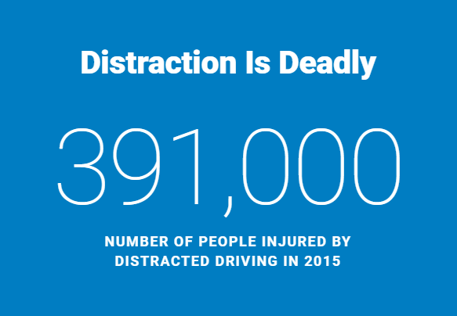
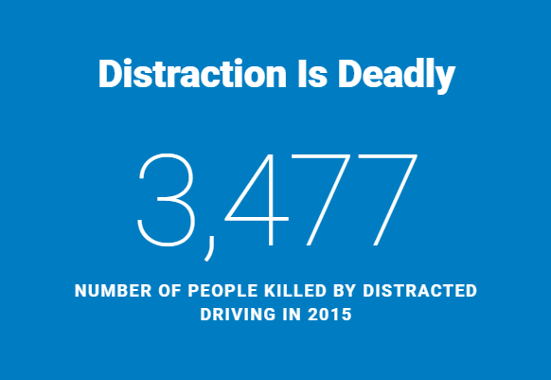
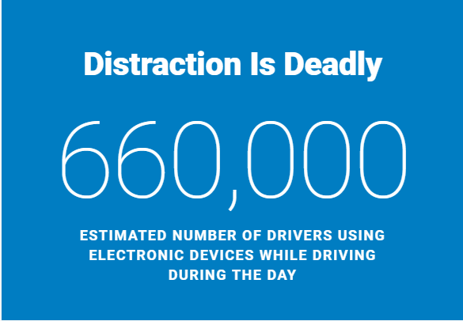
MOTIVATION:
National Highway Traffic Safety Administration
WHO (World Health Organisation) reports 1.25 million deaths on roads throughout the world

Slide 4
DATASET:
Source: Kaggle competitions
Classes: Data:
Class | Description
C0 | safe driving
C1 | texting - right
C2 | talking on the phone – right
C3 | texting – left
C4 | talking on the phone – left
C5 | operating the radio
C6 | drinking
C7 | reaching behind
C8 | hair and makeup
C9 | talking to passenger
TRAINING
TESTING
22,424
images
79,726
images
22%
78%

Slide 5
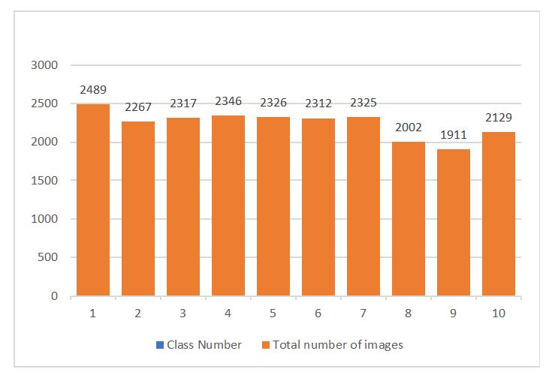
Data Histogram

Slide 6
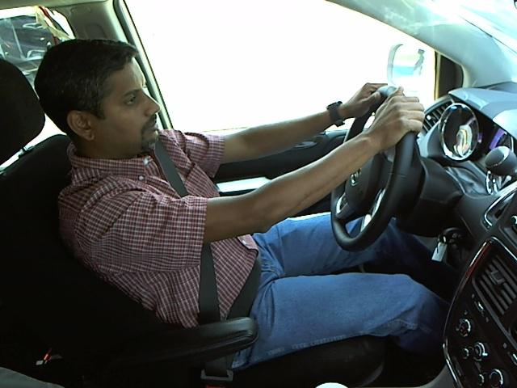
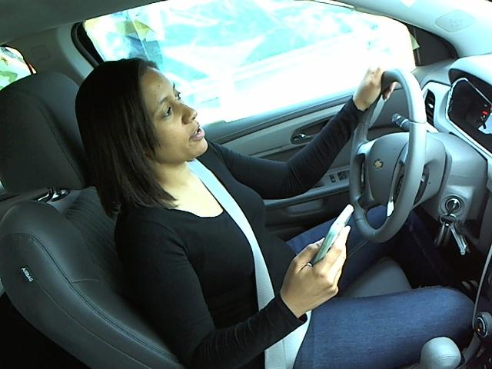
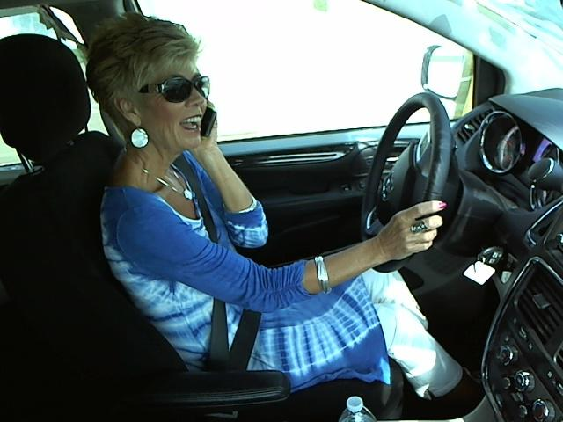
DATASET:
C0: Safe driving
C1: Texting while driving - right
C4: Calling while driving - left

Slide 7
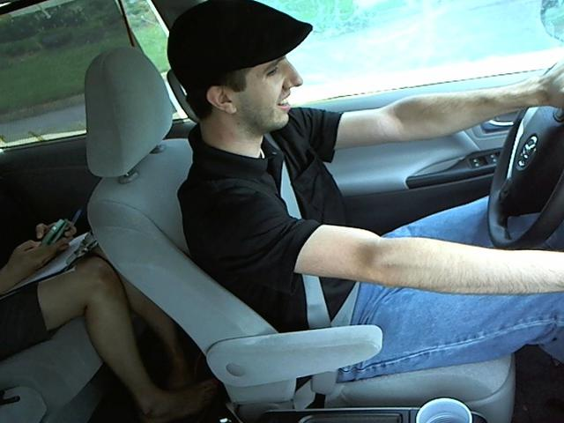
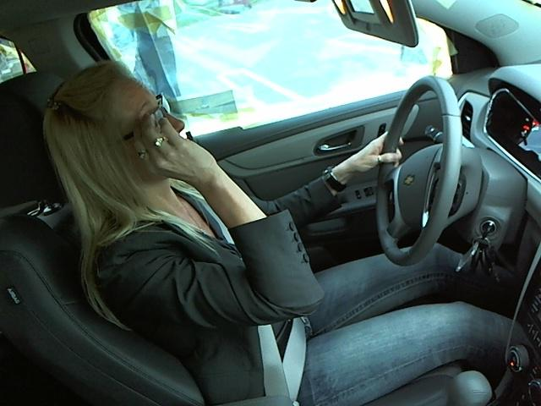
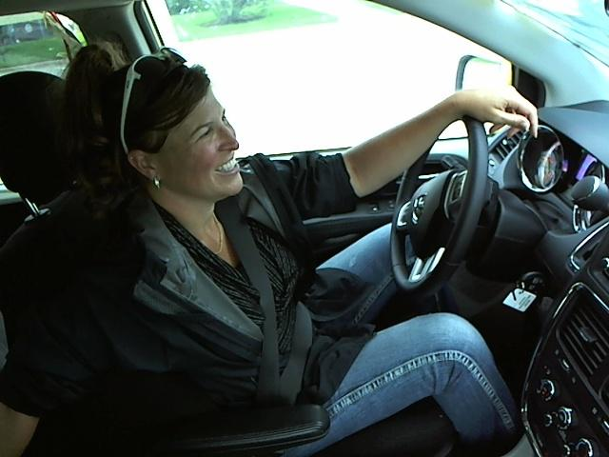
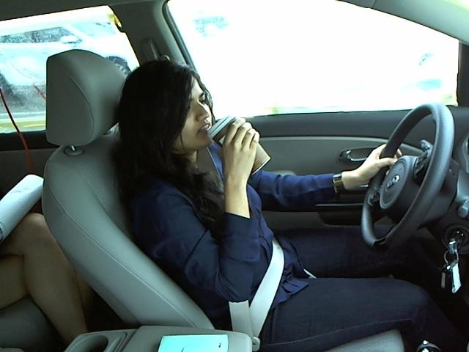

C8: Hair and Makeup
C5: Operating the radio
C7: Reaching behind
C6: Drinking
C9: Talking to passenger

Slide 8
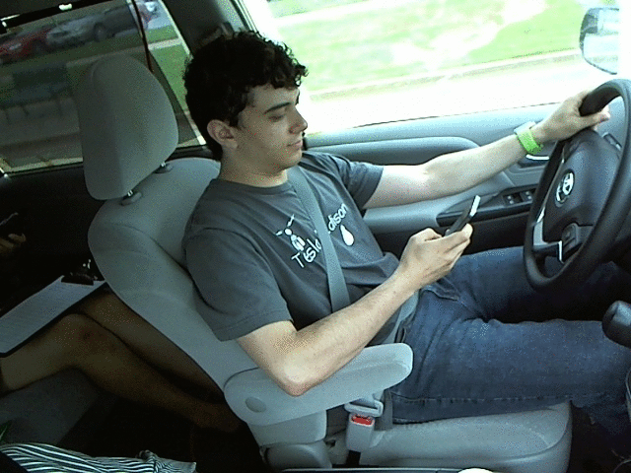

Slide 9
APPROACH:
Small CNN
Small CNN-1
Small CNN-2
VGG_16
VGG-1
VGG-2
ResNet50

Slide 10
SMALL CNN:
.
Dataset (60-20-20) | Number of Images
Train | 13447
Validation | 4490
Test | 4487
 | Input image | Rescaling | Rotation range | Shear range | Zoom range
Small CNN - 1 | 24x24 | - | - | - | -
Small CNN - 2 | 150x150 | 1./255 | 10 | 0.2 | 0.2
Shear angle in counter-clockwise direction in degrees

Slide 11
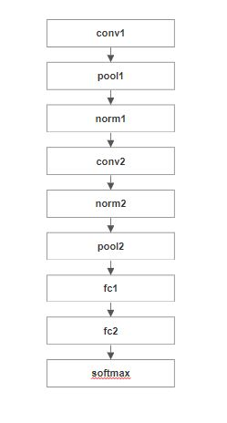
SMALL CNN - 1:
Description | Value
Batch size | 32
Number of epochs | 25
Accuracy | 10.418%

Slide 12
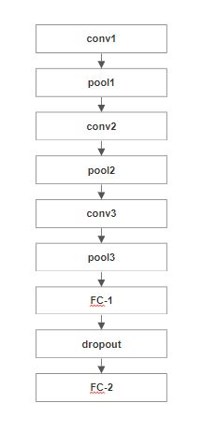
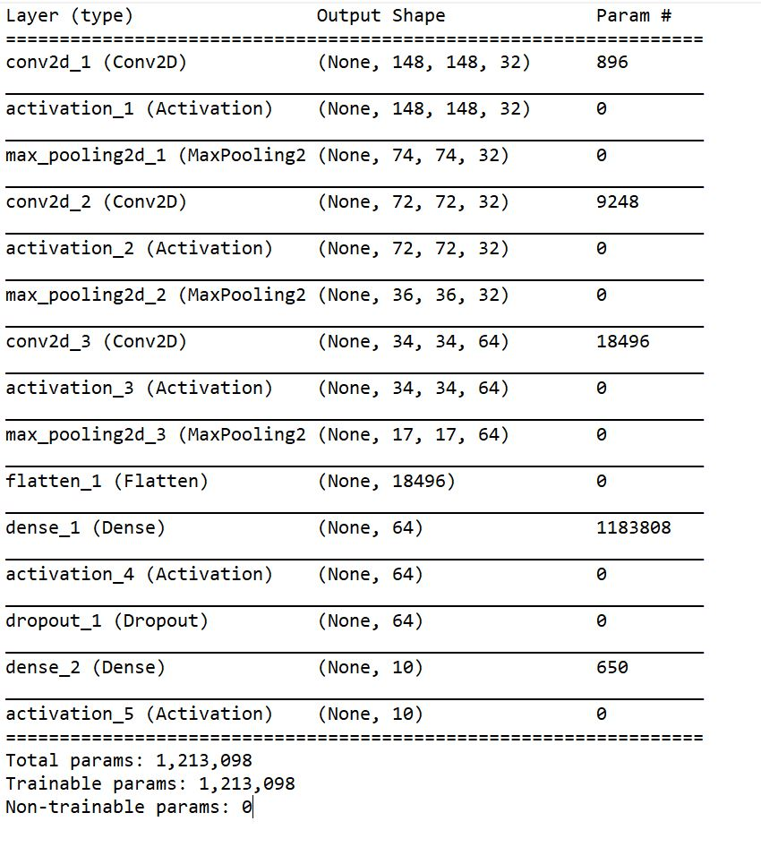
SMALL CNN - 2:
Description | Value
Batch size | 40
Number of epochs | 11 (patience = 3)
Accuracy | 96.8%

Slide 13
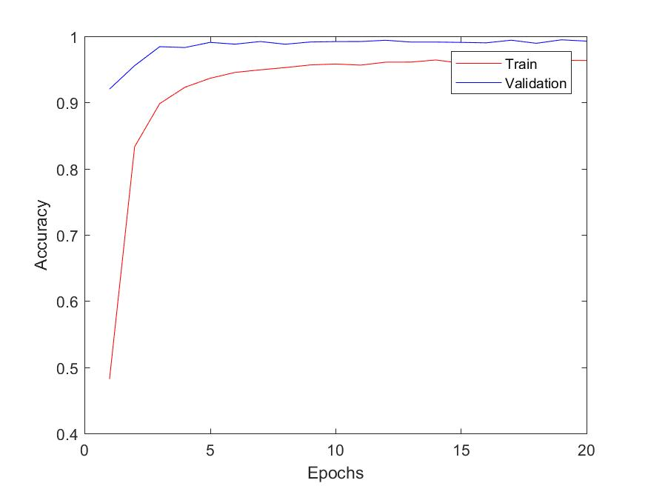
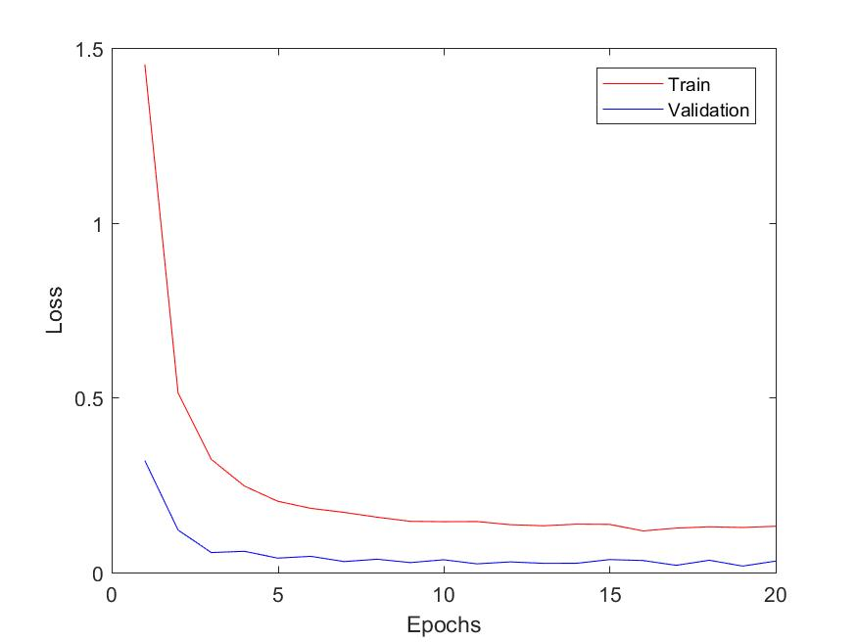

Slide 14
VGG 16:
.
Dataset (70-10-20) | Number of Images
Train | 15688
Validation | 2246
Test | 4490
 | Input image | Rescaling
Training set | 224x224 | 1./255
Validation set | 224x224 | 1./255

Slide 15
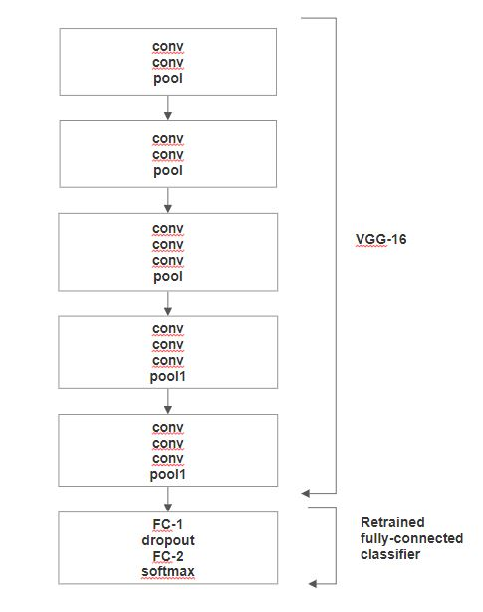
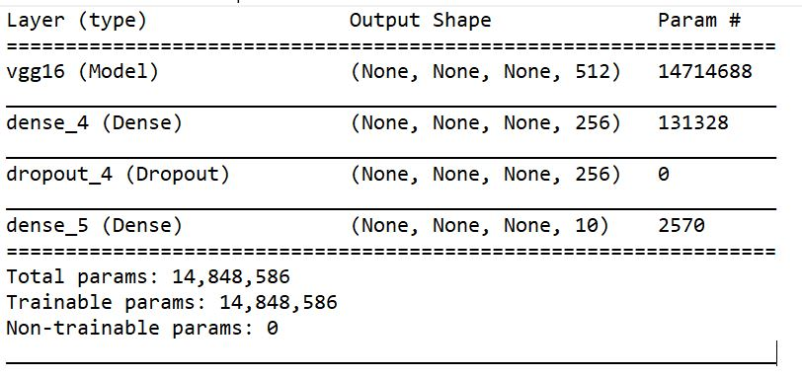
Description | VGG - Best | VGG - 2
Batch size | 64 | 32
Number of epochs | 50 (patience = 5) Stopped after 11 | 50 (patience = 2) Stopped after 13
Accuracy | 99.354% | 99.1%
Loss (crossentropy) | 0.02322 | 0.04889
Optimizer | rmsprop (lr=0.001)

Slide 16
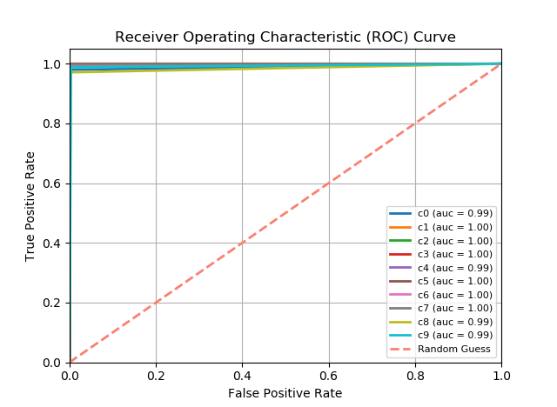
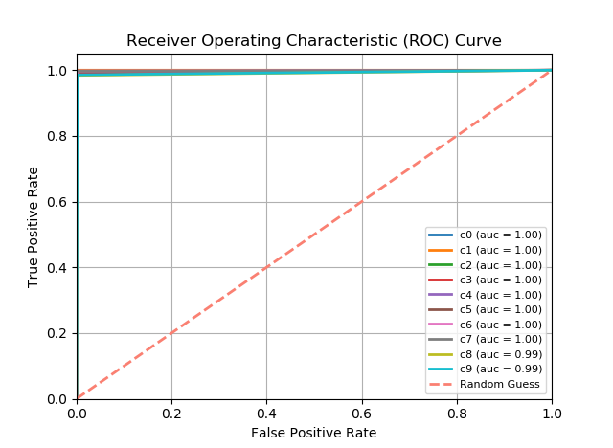
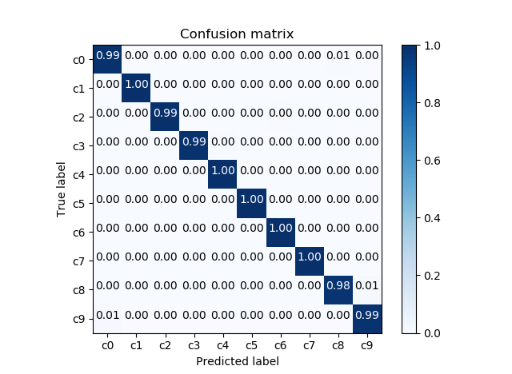

VGG - Best
VGG - 2

Slide 17
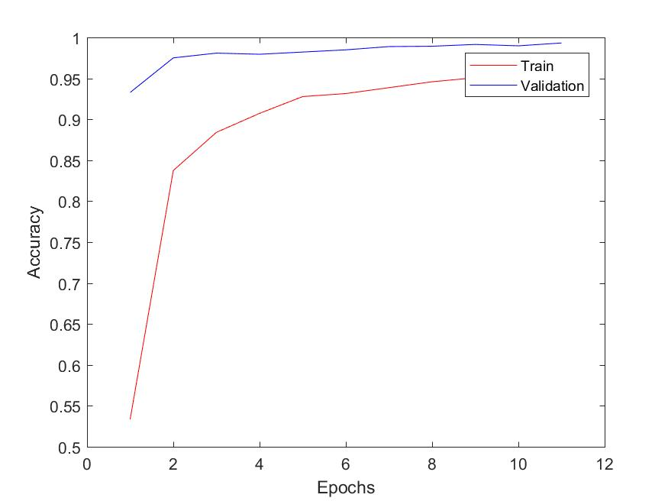
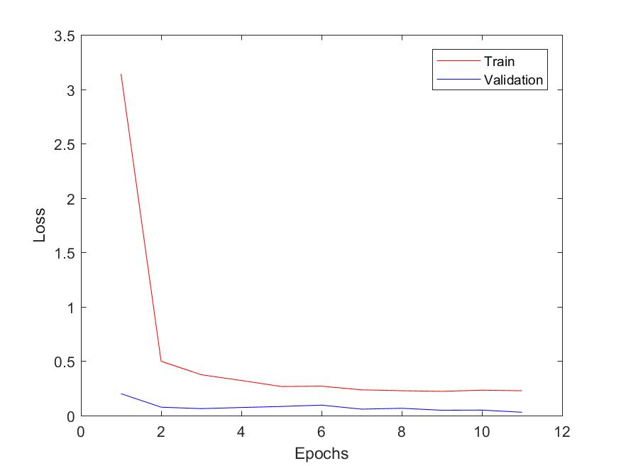

Slide 18
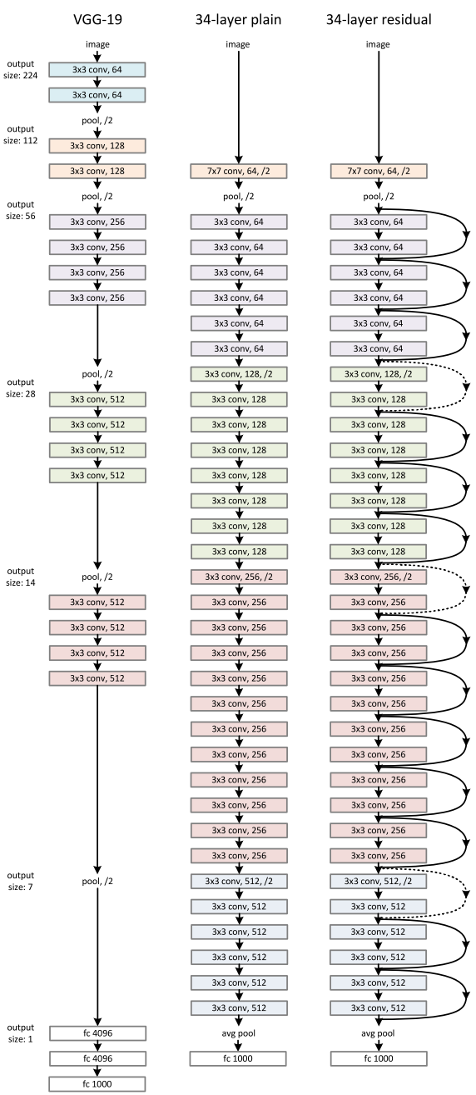
ResNet50
Dataset (70-10-20) | Number of Images
Train | 15688
Validation | 2246
Test | 4490
 | Input image | Rescaling | Rotation_range | Shear_range
Training set | 224x224x3 | 1./255 | 20 | 0.2
Validation set | 224x224x3 | 1./255 | 20 | 0.2

Slide 19
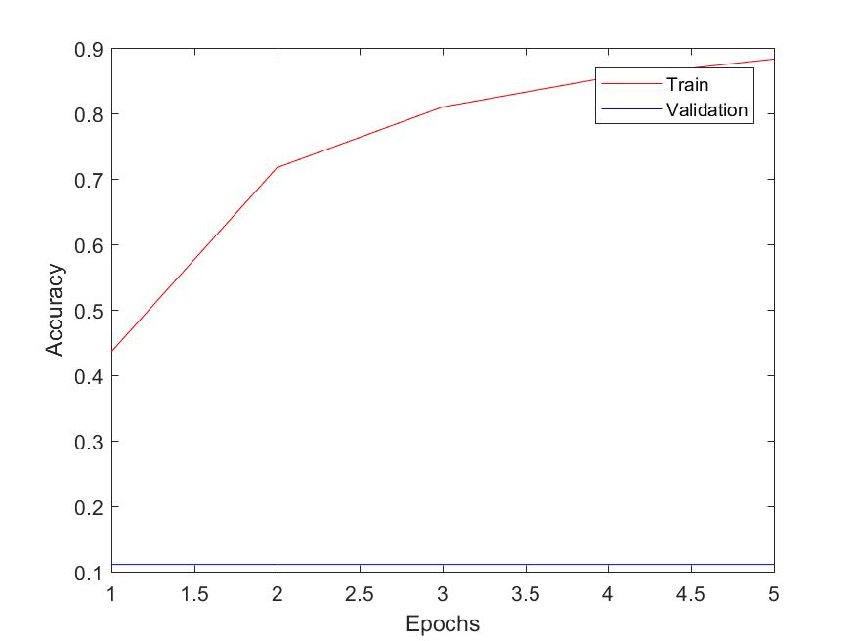
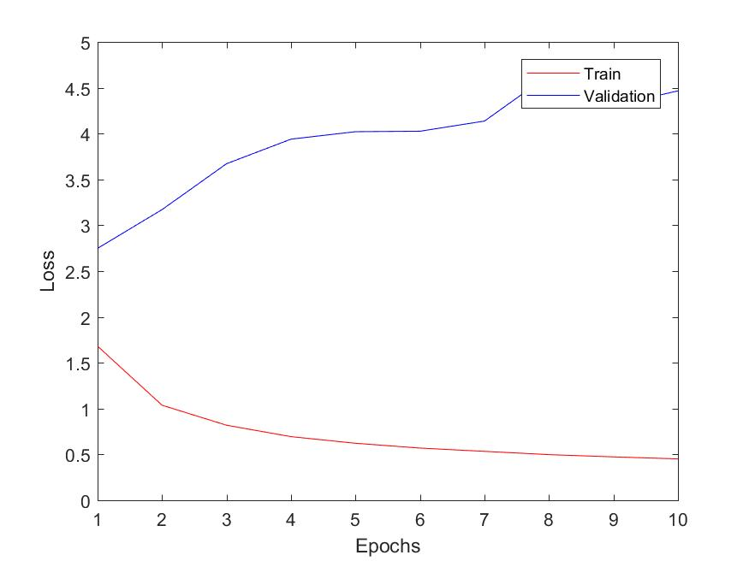
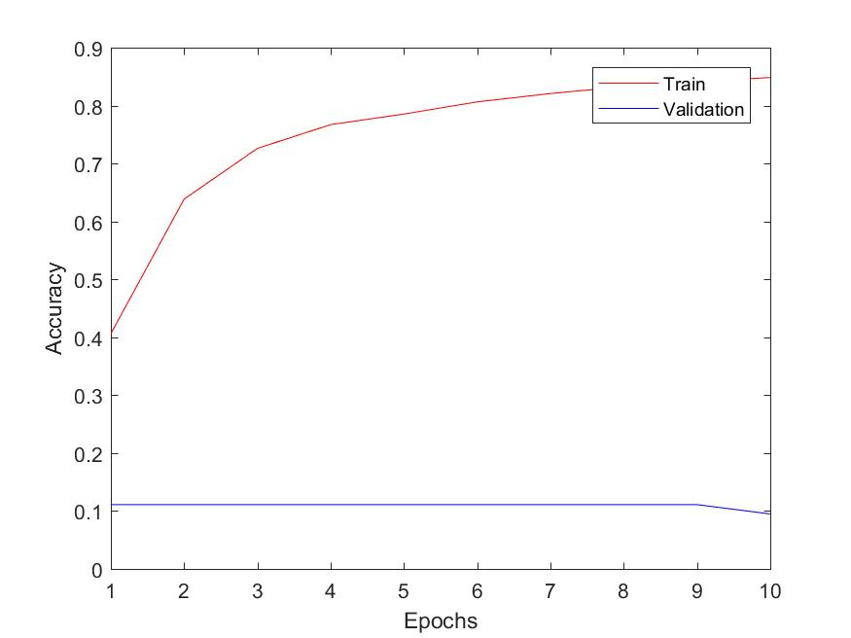
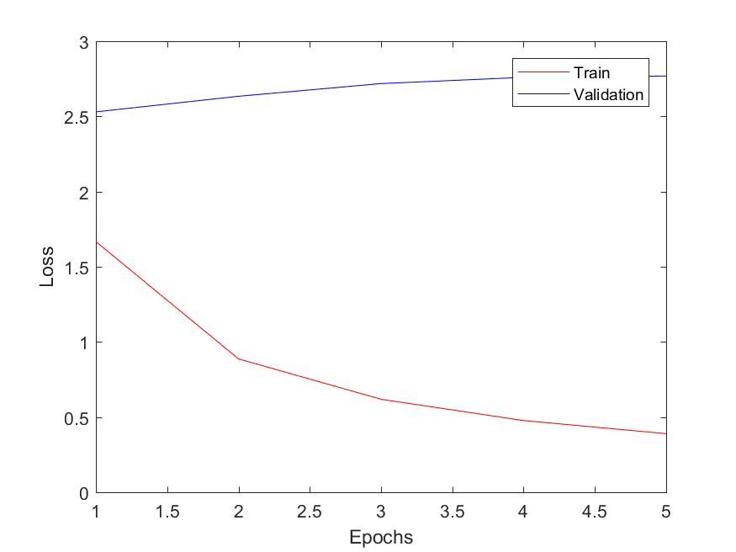

Slide 20
ENSEMBLE LEARNING
Combining two or more networks
Improvement in accuracy

Slide 21
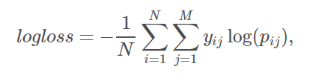
EVALUATION:
Where N is the number of images in the test set, M is the number of image class labels, log is the natural logarithm, $y_{ij}$ is 1 if observation i belongs to class j and 0 otherwise, and $p_{ij}$ is the predicted probability that observation i belongs to class j.

Slide 22
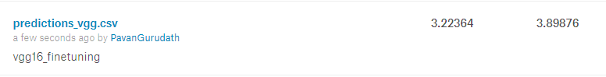
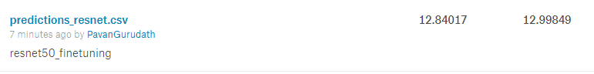
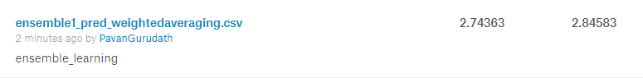
Private Leaderboard Public Leaderboard
VGG-16
ResNet50
Ensemble Learning

Slide 23
REFERENCES:
[1] W. H. Organization et al., “Global status report on road safety, who librar. ed. doi: 978 924 156506 6,” WHO/NMH/NVI/15.6, Tech. Rep., 2015. 2
[2] “National center for statistics and analysis distracted driving 2015. (traffic safety facts research note.report no. dot hs 812 381),” March 2017. 2
[3] Y. Zhang, “Apply and compare different classical image classification method: Detect distracted driver,” December, 2016. 2, 3
[4] C. Streiffer, R. Raghavendra, T. Benson, and M. Srivatsa, “Darnet: A deep learning solution for distracted driving detection,” 2017.
[5] A. Koesdwiady, S. M. Bedawi, C. Ou, and F. Karray, “End-to-end deep learning for driver distraction recognition,” in International Conference Image Analysis and Recognition. Springer, 2017, pp. 11–18.
[6] Kaggle, State Farm Distracted Driver, https://www.kaggle.com/c/state-farm-distracted-driver-detection/data
[7] Francois Chollet. Building powerful image classification models using very little data, 2016.

